Slide 1
Data Security and Privacy Basics
Network Security Fall 2019
Seth James Nielson

Slide 2
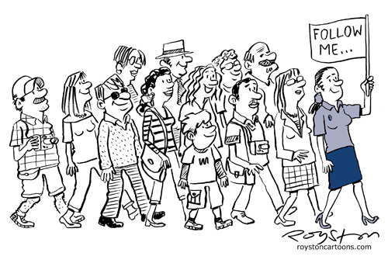
Part I Data Security Basics
Data in Use (brief)
Data in Motion
Data at Rest
My feet are killing me!
This Photo by Unknown Author is licensed under CC BY-SA-NC

Slide 3
Three States of Digital Data
DATA
at REST
DATA
in Use
DATA
in Motion

Slide 4


Securing Data in Use
Data-In-Use:
information in CPU, RAM, registers, etc. for current processing and applications
Security approaches: full memory encryption, secure enclaves, isolated systems, homomorphic encryption
This sounds interesting…

Slide 5

Skipping this idea…
Data-At-Use:
information in CPU, RAM, registers, etc. for current processing and applications
Security approaches: full memory encryption, secure enclaves, isolated systems, homomorphic encryption
We’ll come back to this later.
Why?
Today’s a tight lecture anyway. Data-in-Use is easiest to explain with examples that will come up later.

Slide 6
Securing Data in Motion
Data-At-Motion:
information moving across communications channels including within a computer.
Security approaches: encryption, entity authentication, key management and ephemeral keys, and conscientious governance
“Ephemeral”?

Slide 7
The Origin of Data Security
Almost all of data security was historically for data in motion
Nowadays, the “bad guys” would prefer to steal bulk data in bulk
For this audience Data-at-Rest is probably more interesting too
But securing data-in-motion is still important; let’s discuss TLS
This will illustrate a lot of data-in-motion issues

Slide 8

Standard HTTP Messages
http is the language of the Internet. This is an HTTP Request
http://alice.com
www.alice.com
The HTTP response provides the web page to Bob’s computer
This Photo by Unknown Author is licensed under CC BY-SA

Slide 9

Unencrypted Channels
A hacker can eavesdrop on the unencrypted HTTP communication.
http://alice.com
www.alice.com

Slide 10

Un- authenticated Channels
Worse, a hacker could intercept the request and then impersonate Alice.
http://alice.com
intercepted
www.alice.com

Slide 11
Minimum Data-in-Motion Security
Entity Authentication
Bob needs to know he’s talking to the real Alice,
Bob needs to know his communications with Alice are secret
Bob needs to know that communications can’t be altered
Confidentiality
Data-origin Authentication
This seems familiar!

Slide 12
HTTPS: HTTP over TLS
Before the HTTP request is sent, TLS creates a secure channel.
https://alice.com
www.alice.com
TLS stands for Transport Layer Security.
It replaced SSL, Secure Socket Layer, although that name is still used.

Slide 13
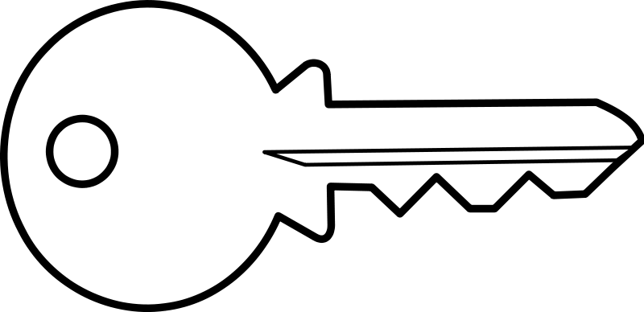
TLS*: Start with a Firm Handshake
TLS: Client Hello
TLS: Server Hello
Alice.com
Cert
K
www.alice.com
Alice sends her certificate and an asymmetric key that will be used to create a temporary symmetric key.
*For simplicity, these TLS examples relate to version 1.2

Slide 14
TLS: Stranger Danger
TrustMe
Cert
Signed By
Alice.com
Cert
Bob verifies the certificate by checking if it is signed by someone he trusts and has the right data (i.e., for Alice)

Slide 15
TLS: Get a Temporary Key
After verifying Alice’s certificate, Bob sends an asymmetric key of his own.
K
TLS: Client Key Exchange
TLS: Start Encrypting
Using these asymmetric keys, Alice and Bob can create a 1-time use (ephemeral) symmetric key!
K
Alice’s private Key
Alice’s public Key
K
K
Bob’s public Key
Bob’s private Key
K

Slide 16
TLS: Bulk Data
Using the symmetric key, Alice and Bob exchange encrypted messages using AES
TLS: Encrypted HTTP data
TLS: Encrypted HTTP data
The data is also sent with a MAC to ensure data origin authentication

Slide 17
Other Data-in-Motion Issues
Data-in-Motion shows up in:
A single system when data moves from the hard drive to RAM
An enterprise system as data flows between systems
A system made up of multiple computers (e.g., data lake)
One enterprise system to another
TLS provides an overview and an intro to data-in-motion issues
There are other security concerns, of course
Many of these concerns show up in data-at-rest
So for now, let’s move on
(We’ll see some data-in-motion examples near the end of class!)

Slide 18
Securing Data at Rest
Data-At-Rest:
inert information stored on physical media such as disks, tapes, databases, etc.
Security approaches: encryption, access controls, key management, audits, tokenization, and conscientious governance
Now this is more like it!

Slide 19
Skipping this Idea too…
Data-At-Rest:
inert information stored on physical media such as disks, tapes, databases, etc.
Security approaches: encryption, access controls, key management, audits, tokenization, and conscientious governance
We aren’t going to talk much about this today.
Why not?!
Data in Motion isn’t as applicable to “Network” Security

Slide 20
The New World of Big Data, Cloud Storage, etc.
The tech world has changed drastically within the last decade
Companies are accelerating moving data resources to the cloud
Big data is… well, big. And technologies are changing to match
New technologies are introducing new security challenges
For example, “Data Lakes” have to protect data in all 3 states!

Slide 21

Data Lake Overview
A data lake stores raw data, from wide input sources, into a single logical store. Using search and “big data” engines, it provides discovery, analytics, reporting, and so forth.
Alice’s engineering
team
Reports, Analysis, Discovery, etc.
Bob’s Sales
Office
Search/Data Engines
Interconnected Storage Devices
(raw, unformatted data)

Slide 22
Data Lake Security Challenges
Wide variety of data stored together.
Where did data come from?
Who touched it?
Who is authorized to access it?
All three states of data! (rest, motion, use)
Encryption questions abound, especially for processing
Access control questions outside, and inside, the lake
Most of the advice I find is about outside access
But a “Data Lake” is a concept on top of hardware. Who has access?
Some data experts recommend not storing PII in the Data Lake!

Slide 23
The Gmail Example
I still use Gmail for personal email, and Google for my business
I do not end-to-end encrypt my mail
It is encrypted “at rest” on Gmail servers
But it is un-encrypted and analyzed by Gmail search servers
I could use proton mail for completely secure email, but I don’t.
Why? Because I’ve come to rely on Gmail search.
I’m not sure I could function without this search capability
Unfortunately, I have to trust Google with my data for this

Slide 24
Part II Summary
We’ve talked primarily about securing Data-in-Motion
But all three states matter for network security at least indirectly
Data Lakes deal with security in all states
The focus has been security; now we need to talk about Privacy.

Slide 25
Part II Data Privacy Basics
What is Privacy?
Data Sensitivities
Regulatory Issues
Query Controls
How long is this tour?!
This Photo by Unknown Author is licensed under CC BY-SA-NC

Slide 26
Data Privacy
Data Privacy:
is the relationship between dissemination of data and the gathering/use/management thereof. It includes legal, policy, and technical issues.
For our class, we will only talk about the technology issues.
Who cares?

Slide 27
Why it matters
Data Privacy:
is the relationship between dissemination of data and the gathering/use/management thereof. It includes legal, policy, and technical issues.
For our class, we will only talk about the technology issues.
People care because data collected about them could be used to manipulate, rob, embarrass, blackmail, or even control them.
Control them?!

Slide 28
Data as a Means of Control
Yes, control. Some experts are concerned that genetics might be used to control where you live or go to school.
Where you live? Go to school? How?
A condo association forces you to submit to a DNA test. If you have a predisposition to Alzheimer’s disease, you can’t live there.
That’s terrible!
And right now, some feel Big Data is being used to exploit individuals with addiction issues. Is that “control” or just “manipulation”?
Ugh! It doesn’t matter!

Slide 29
Technology vs Law vs Policy
But shouldn’t we just pass laws banning these kinds of activities?
Maybe. But we also have to develop technologies that can keep data private so that there isn’t even the option to disseminate.

Slide 30
Data Ownership vs Stewardship
Who “owns” data about you? This is a legal/political question
In Europe, laws generally support that you own the data about you
In the United States, laws are generally moving towards this
For purposes of this class, we assume a user owns their own data
We will call one who handles data for another a data steward*
* McGilvray, pp. 53-54
O’Keefe, pp. 102-105, 236-244

Slide 31
Data Privacy Technology Goals*
Enable identification of ownership and stewardship of data
Enable owners to maintain policy for their own data
Enable stewards to communicate data handling to owners
Enable data handling by a steward to adhere to owner policy
Enable permitted data handling to expose minimal privacy risk
Enable accountability of data stewards to data owners
Enable transparency of data, handling, stewardship to owners
*Others have expressed similar goals differently.
These are Dr. Nielson’s formulations.

Slide 32
Personal Information/PII
In practice, data privacy begins with identifying “personal” data
The defined set of personal data varies by legal jurisdiction
For example, in Europe an IP address is personal, but not in the US

Slide 33
PII in the United States
“any information about an individual maintained by an agency, including (1) any information that can be used to distinguish or trace an individual's identity, such as name, social security number, date and place of birth, mother's maiden name, or biometric records; and (2) any other information that is linked or linkable to an individual, such as medical, educational, financial, and employment information.”
(NIST Special Publication 800-122, emphasis added)

Slide 34
PII Audit
Ok Alice, I’m sold. I want to make privacy a priority. Where do I start?
I’m tempted to suggest Privacy by Design*, but for now let’s start with a PII Audit. You can’t protect data you don’t know about.
* See O’Keefe, pp. 259-260, 265

Slide 35

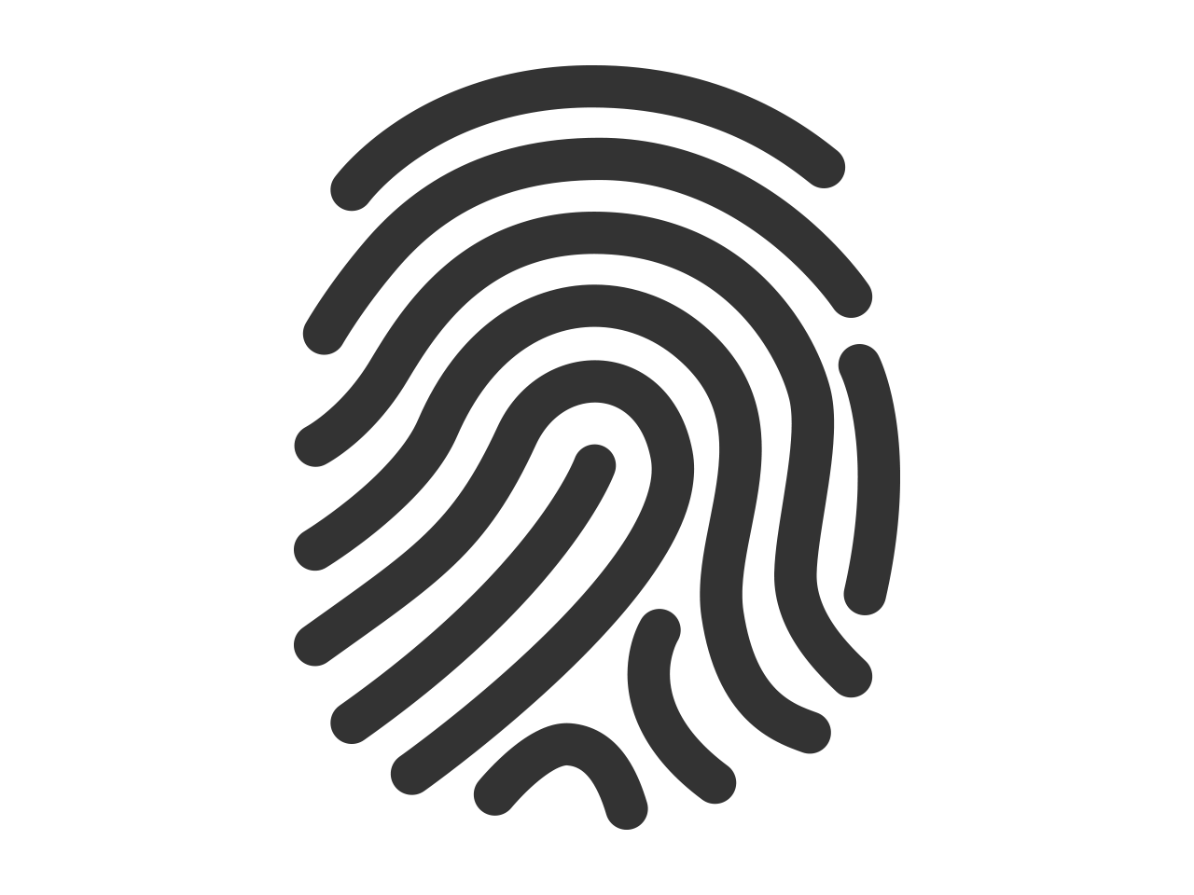

Distinguishing Data
This Photo by Unknown Author is licensed under CC BY-NC
Obviously, any data that directly identifies someone is PII. NIST calls this “distinguishing” data. It includes name, DOB and even biometrics.
This Photo by Unknown Author is licensed under CC BY

Slide 36
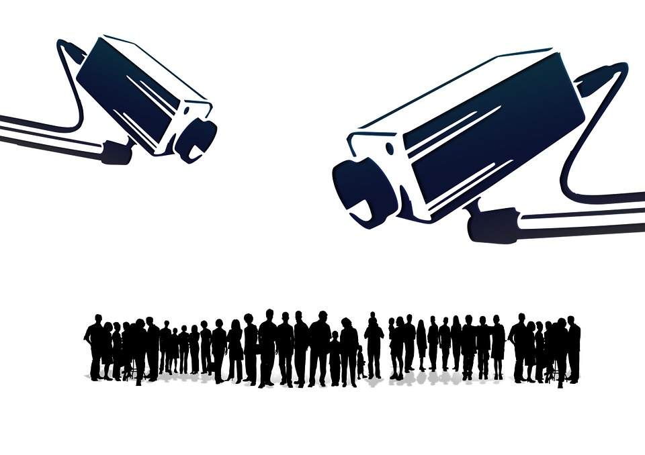
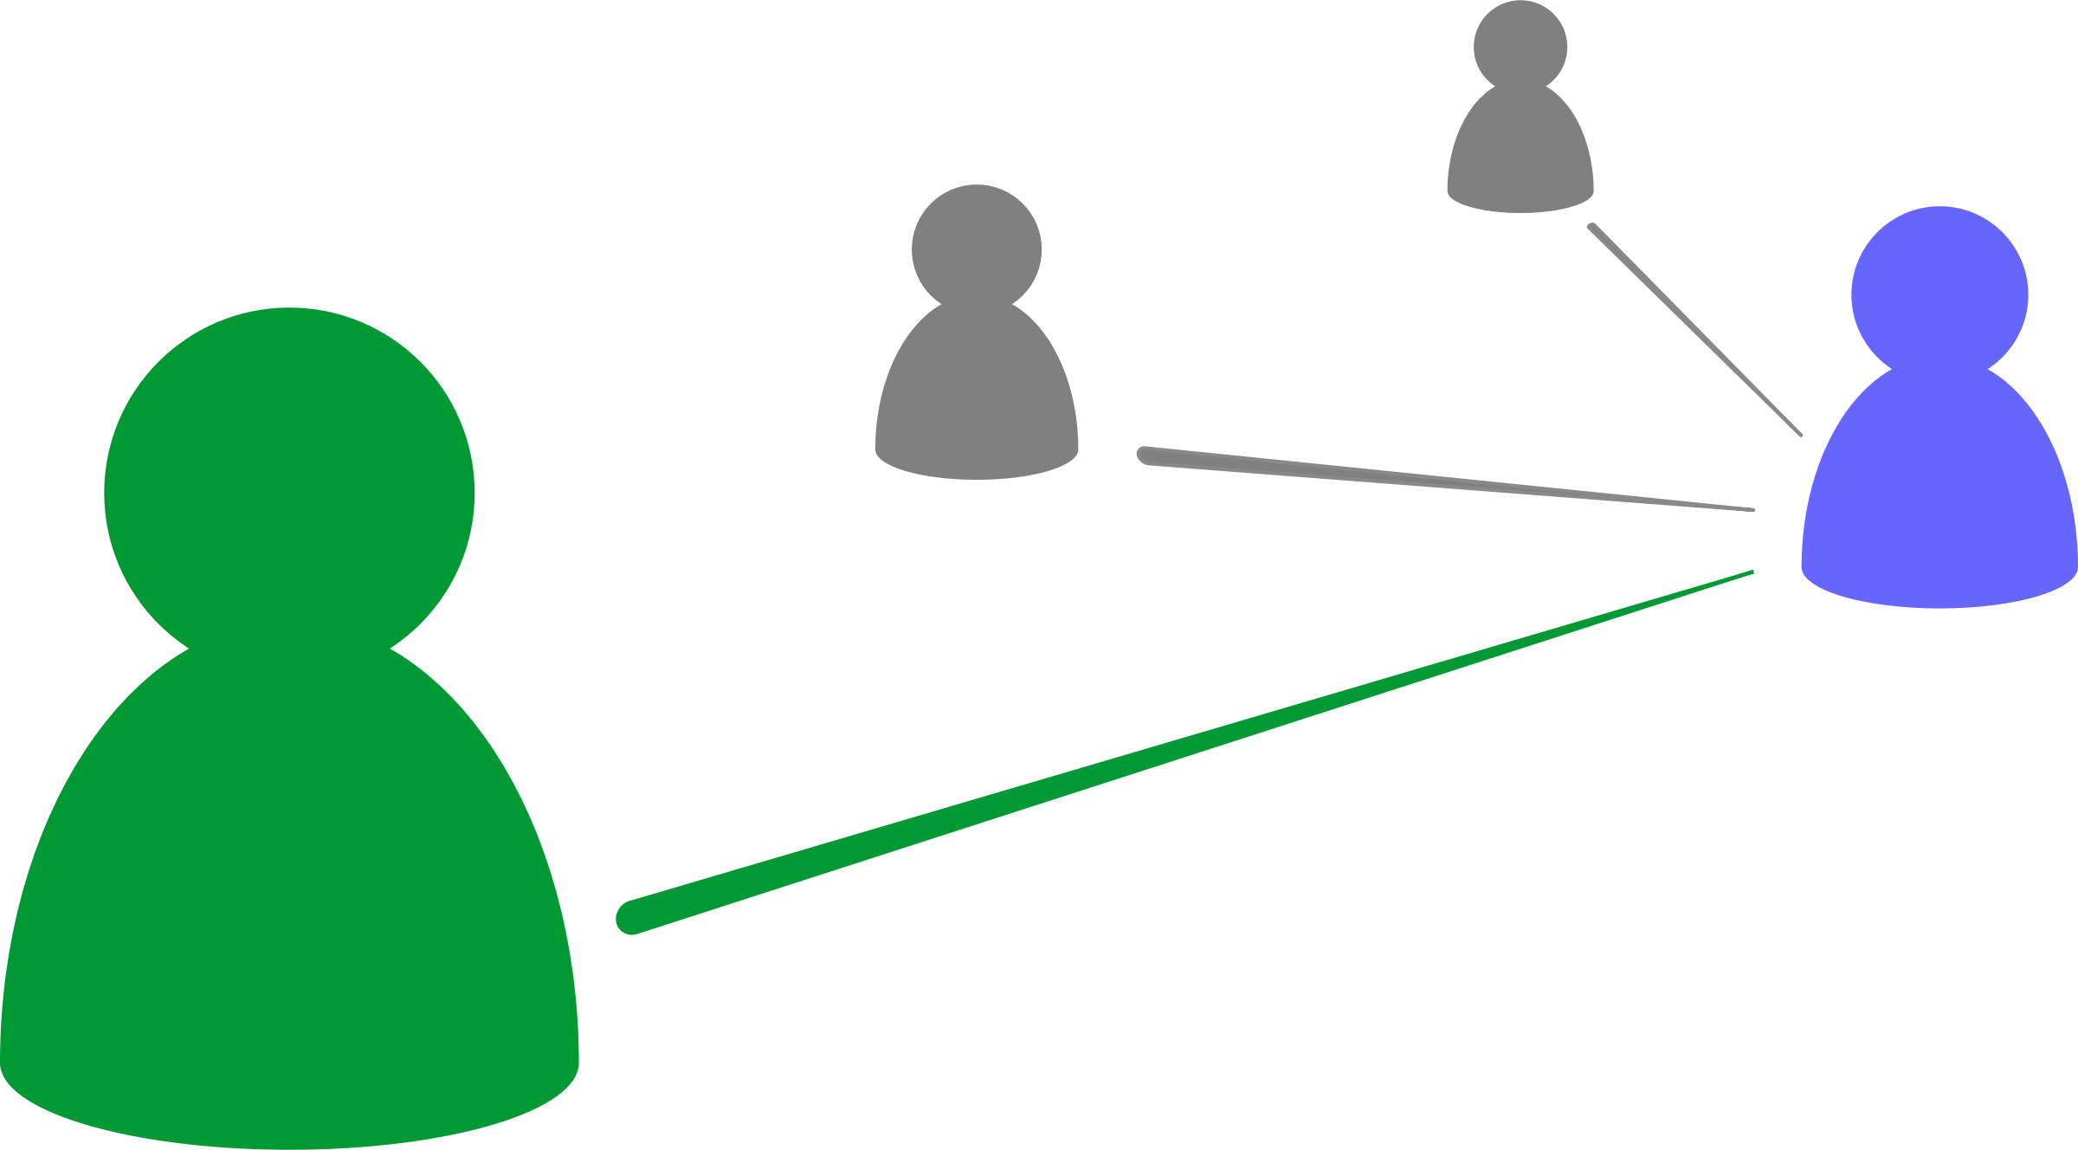
Tracing Data
PII also includes data that could be used to determine an individual’s activities or status. This includes log files or camera recordings.

Slide 37

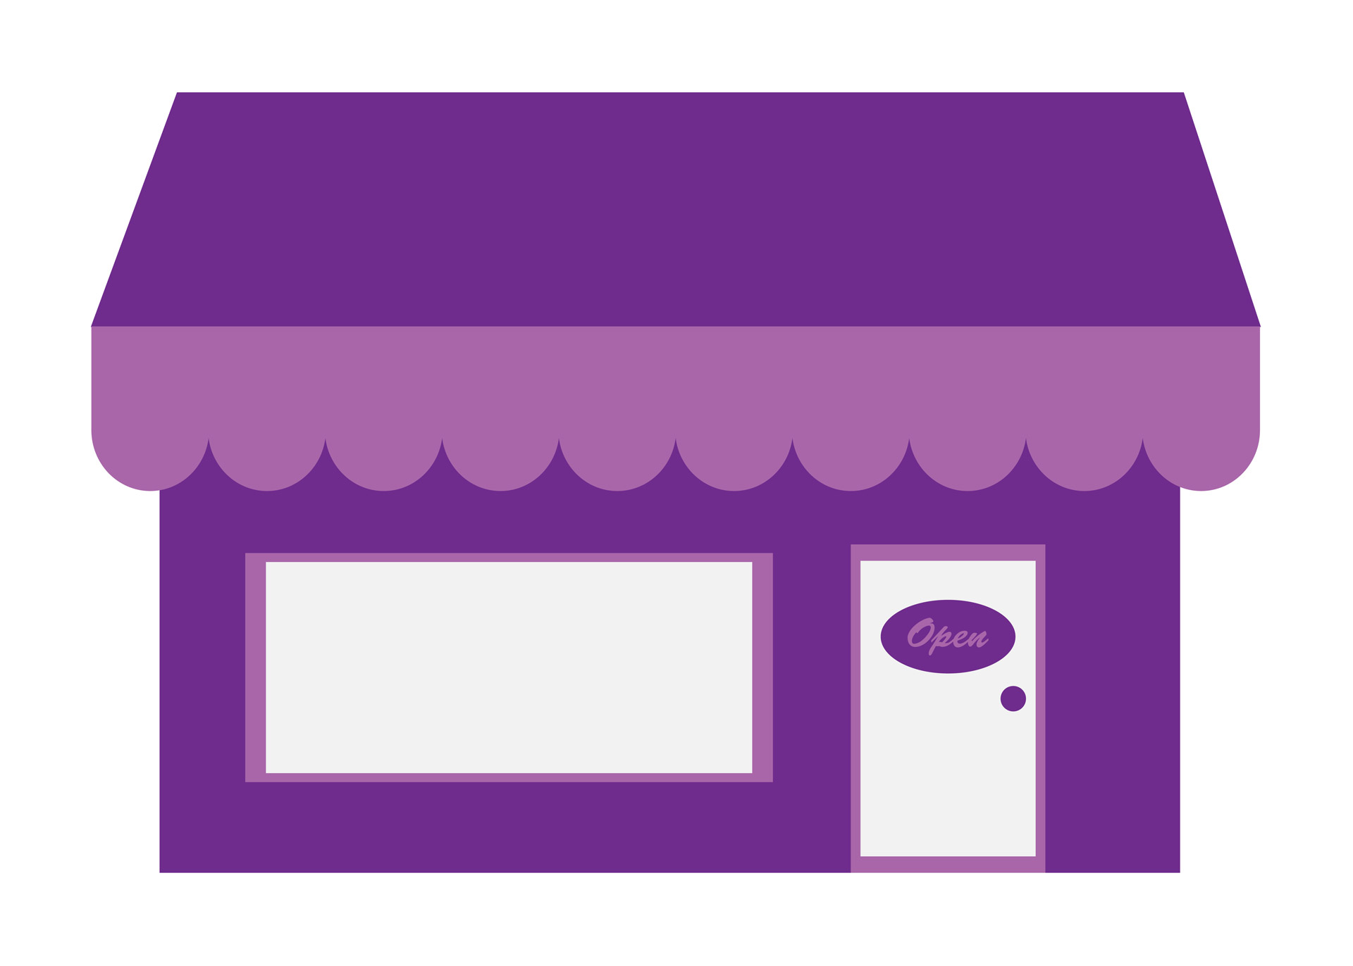
Linking Data (linked or linkable)
This data is already linked to the student
This data could be linked to the student
This Photo by Unknown Author is licensed under CC BY-SA-NC
School Uniforms Online Store
Student | Grade | Height | Weight
Bob Jr. | 5 | 4’5” | 100lbs
Grade | Height | Weight | Purchases
5 | 4’5” | 100lbs | $100.00
Finally, “linked” data is data already linked to the person. “Linkable data” is data that could be linked to the person.

Slide 38
PII Audit Solutions
That’s a lot of PII! How can I find all of it?
Start by reading NIST SP 800-122. It has a number of good starting points. If you’re doing business in Europe, you may need a GDPR specialist.

Slide 39
PII Safeguards*
Privacy-Specific Safeguards
Minimizing the Use, Collection, and Retention of PII
De-Identifying Information
Anonymizing Information
Security Controls
Access Enforcement
Auditable Events
Information System Monitoring
Media Sanitization
* This is a subset of safeguards described in NIST SP 800-122

Slide 40
Minimizing PII Use, Collection, and Retention
The first, and perhaps most important step, in protecting PII is NOT TO COLLECT, USE, and/or RETAIN it.
That’s impossible!
It very well might be! If you’re a medical records company, you have to. But start with this mindset.
We’re a data company. Processing data is what we do.
Start by remembering it isn’t your data. You should only have data you absolutely need.

Slide 41
Minimizing PII Use, Collection, and Retention (2)
If you absolutely must have PII data, minimize all engagement with the data.
Meaning?
Limit the roles that can access the data, limit the users assigned to those roles. Limit PII processing and limit where it is stored.
How do you limit where it is stored?

Slide 42
Limiting PII Storage
Do not permit PII inputs unless explicitly authorized
Fence non PII DB’s to screen for accidental insertion attempts
Block access to PII for unauthorized applications and users
Data Input
Non-PII Processing
Normal Storage
Data Input
PII Processing
Data Input
PII Storage
PII Processing
Ensure PII is deleted from ingress systems
Ensure PII resides in a single (logical) DB. This is harder than it sounds.
Watch out for caching or unauthorized replication

Slide 43
Minimizing PII Use, Collection, and Retention (3)
Minimize retention. Securely delete PII the moment it is no longer needed. This is easier if you limited storage and use.

Slide 44
De-Identification and Anonymization
Replacing fields with a hash or other opaque identifier is sometimes called tokenization
De-identified data can be re-identified. Must be on a separate system with access controls.
Also, must not be re-identifiable with publicly available data.
De-Identification
Replacing PII fields with an opaque identifier, such as the cryptographic hash.
PII Storage
Normal Storage
Anonymization
Replacing PII fields with aggregates, lower quality variants, or even incorrect values when appropriate.
Examples include replacing a specific field with the average across all records or even shuffling PII fields amongst the records in the set.

Slide 45
Access Controls
Obviously, access control to PII is critical.
So, only letting certain users have access.
Yes, but there are other options. You could have a program that grants mediated access to the PII
ACCESS GRANTED
ACCESS DENIED
PII Storage
PII Access

Slide 46
Auditable Events and System Monitoring
Any PII activity that violates policy, even if unsuccessful, should be audited.
Information monitors, such as data loss prevention systems can find and block PII transfers
Data Input
Non-PII Processing
Normal Storage
Data Input
PII Processing
Data Input
PII Storage
PII Processing

Slide 47
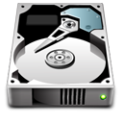
Media Sanitization
When media that has stored PII has reached the end of its lifecycle, it should be sanitized.
This I have heard about. You basically make the media unusable
PII Storage
This Photo by Unknown Author is licensed under CC BY-SA
Yeah, with hard drives there’s a process called degaussing, which uses a magnetic field.

Slide 48
Security and Privacy Summary
We’ve covered a lot of ground for both security and privacy.
One point that should be clear: both are complex subjects
Your organization may need an SME to help you navigate
But, as the data person, you hold the keys to the most critical part!

